Slide 1

Human Activity Recognition
Building classification models for Recognizing the Human Activities Based on the Accelerometer Axial Data
Karthi Narendrababu Geetha
S3835901

Slide 2
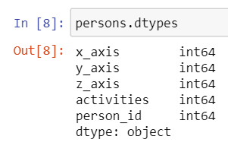
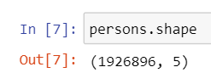
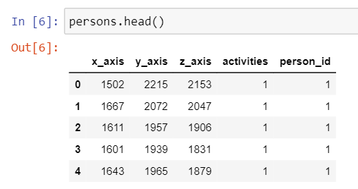
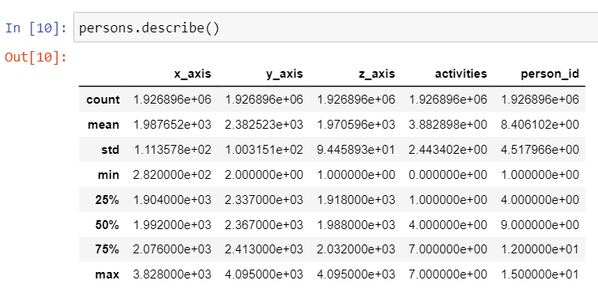
Data Acquisition

Slide 3
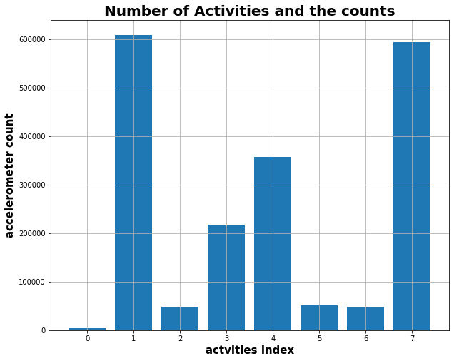
Data Preparation

Slide 4
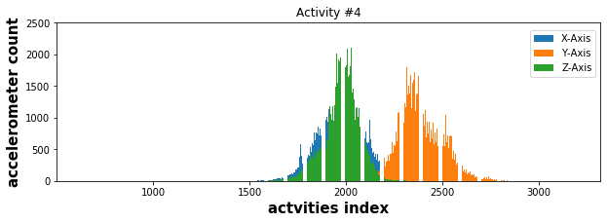
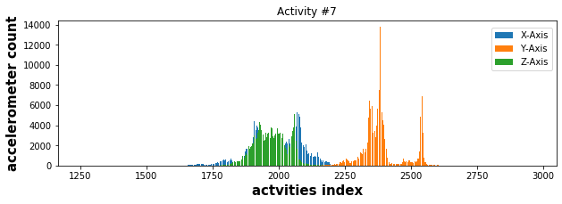
Data Exploration - EXPLORING THE X, Y AND Z AXIS OF ACCELEROMETER:

Slide 5
Data Modelling
Feature Selection
Train, Test Split
Initializing the modelling technique
Training the data
Hyper Parameter Tuning
Validating the model
Confusion Matrix
Classification Report
Cross Validation

Slide 6
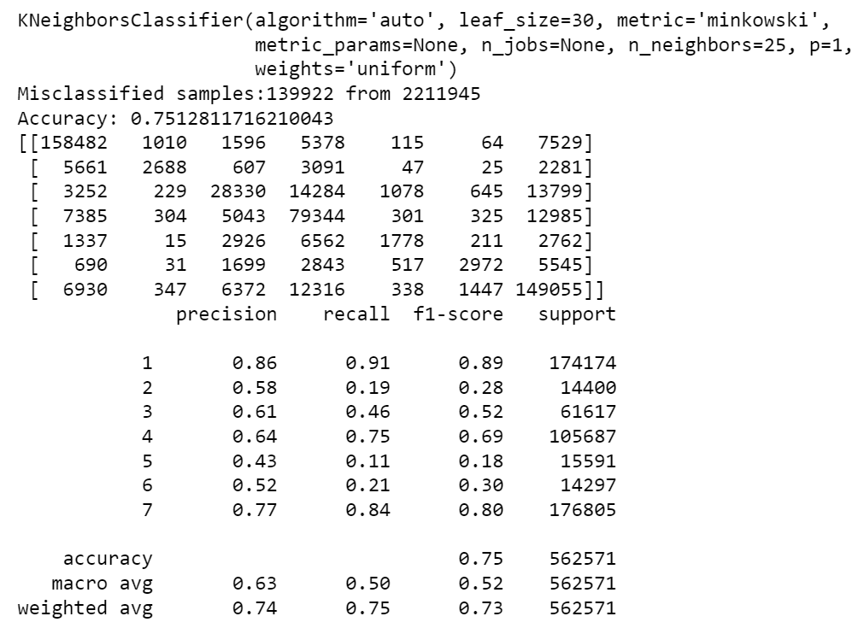
Result - K Nearest Neighbor Classification

Slide 7
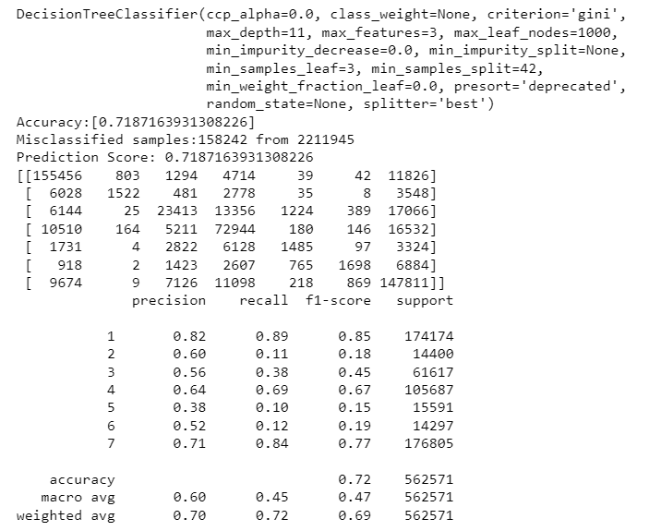
Result – Decision Tree Classification

Slide 8
Conclusion & Recommendation

Slide 9
Thank you

